Slide 1
UCSB Linguistics 25 years of awesome!

Slide 2
Classes and Fieldwork

Slide 3
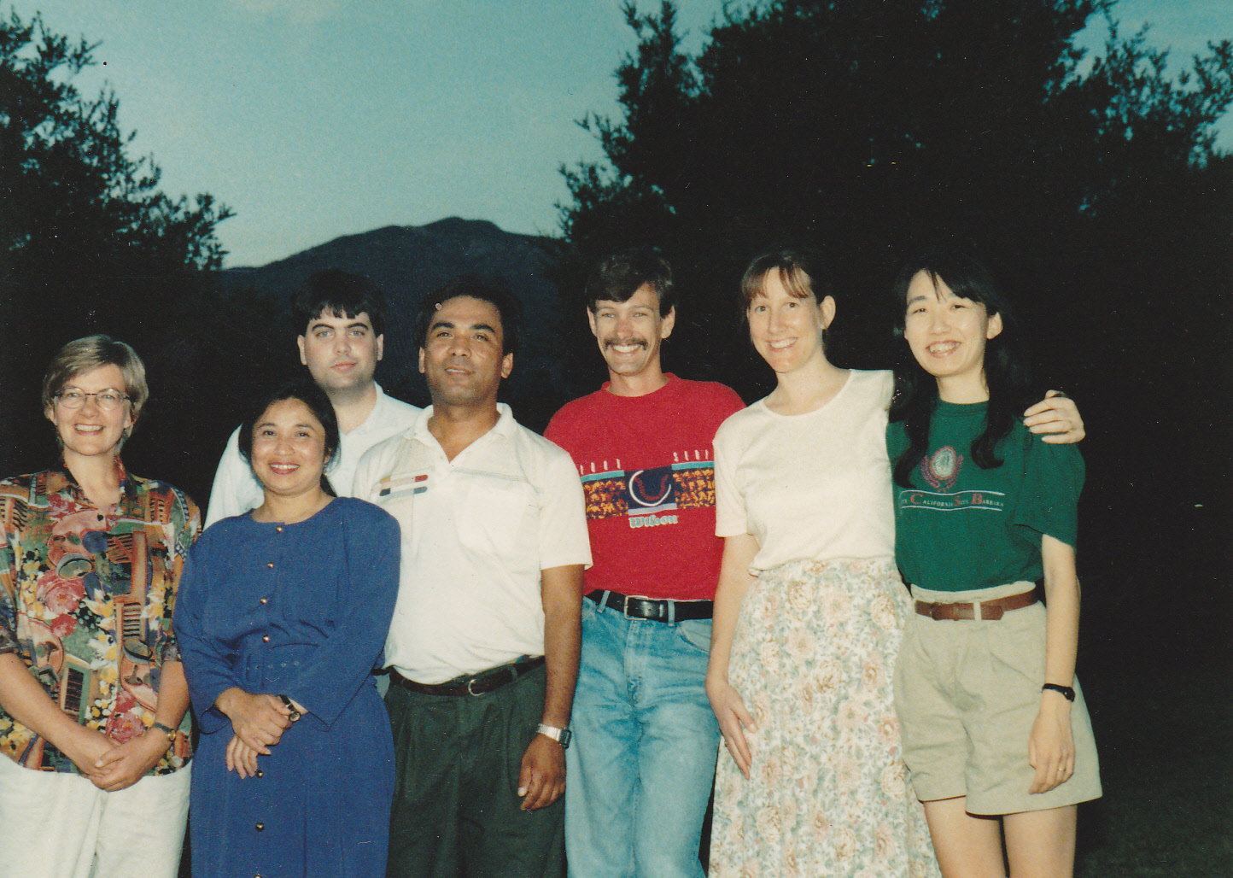
Field Methods 1993-1994
Notes:
field methods 93-94

Slide 4
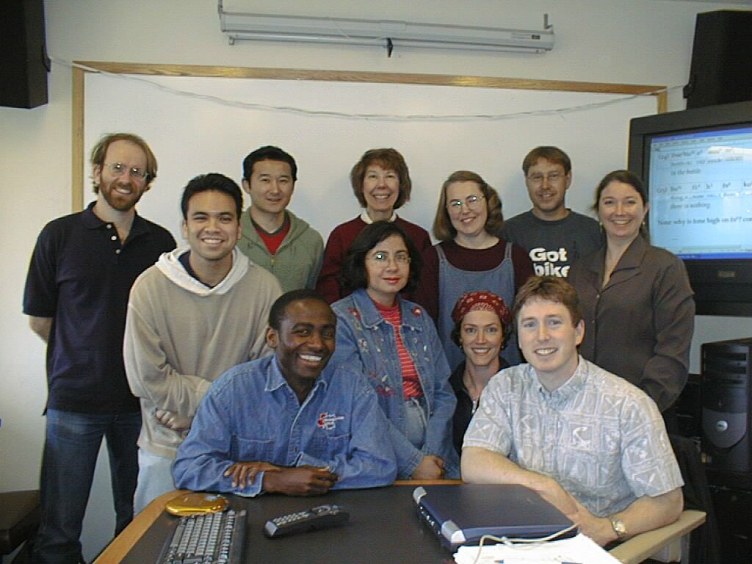
Field Methods 2002-2003
Notes:
field methods 02-03

Slide 5
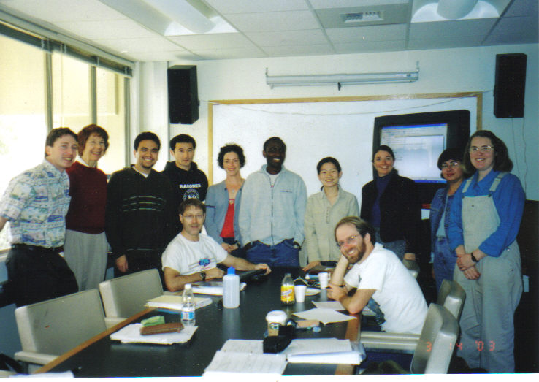
Field Methods 2002-2003
Notes:
field methods 02-03

Slide 6
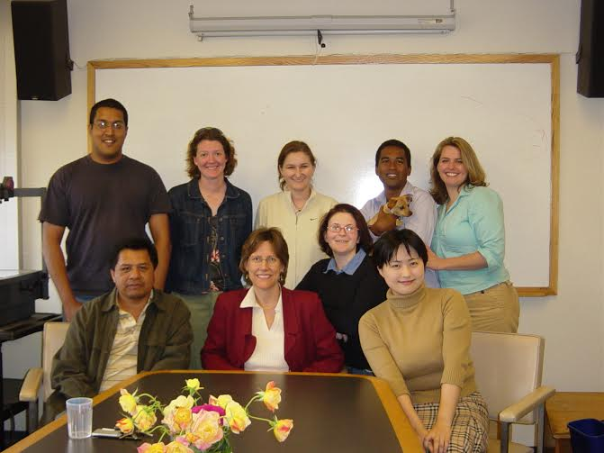
Field Methods 2005
Notes:
Field methods 2005

Slide 7
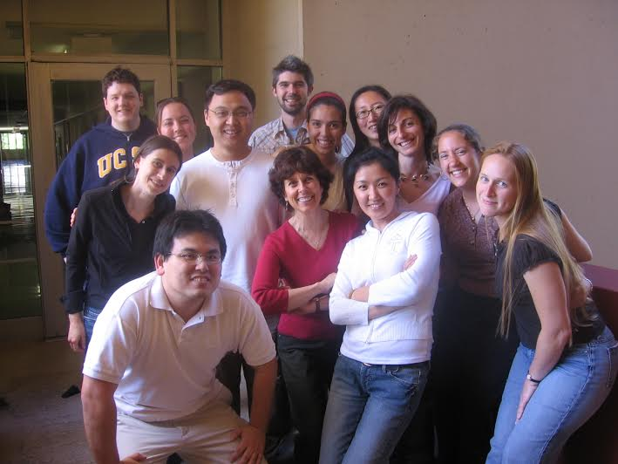
Field Methods 2006-2007
Notes:
field methods 06-07

Slide 8
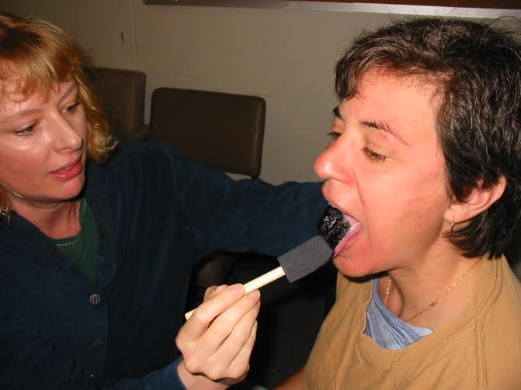
Experimental Phonetics
Notes:
exp phonetics

Slide 9
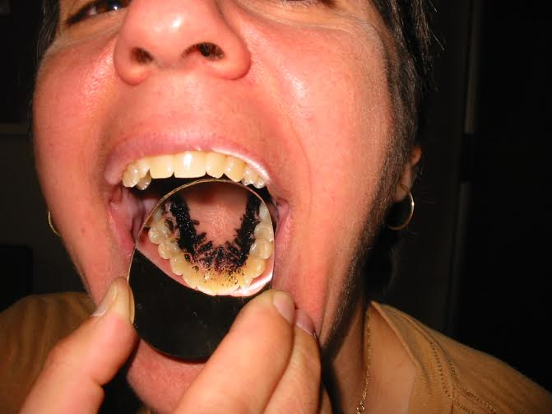
Experimental Phonetics
Notes:
exp phonetics

Slide 10
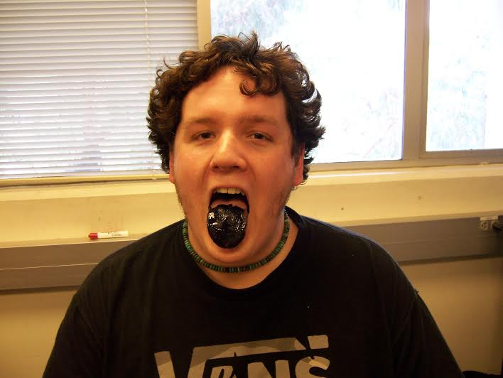
Experimental Phonetics

Slide 11
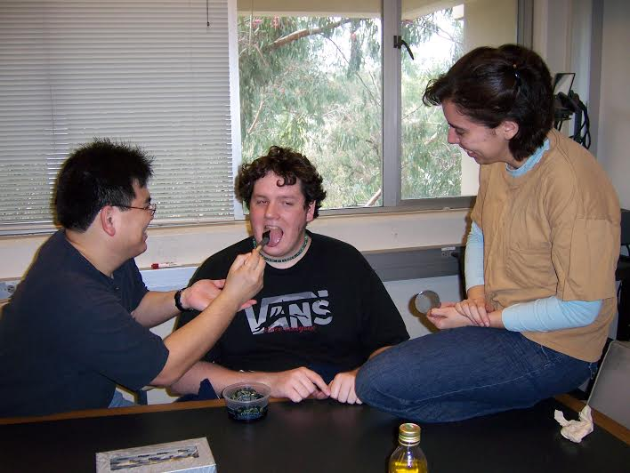
Experimental Phonetics

Slide 12
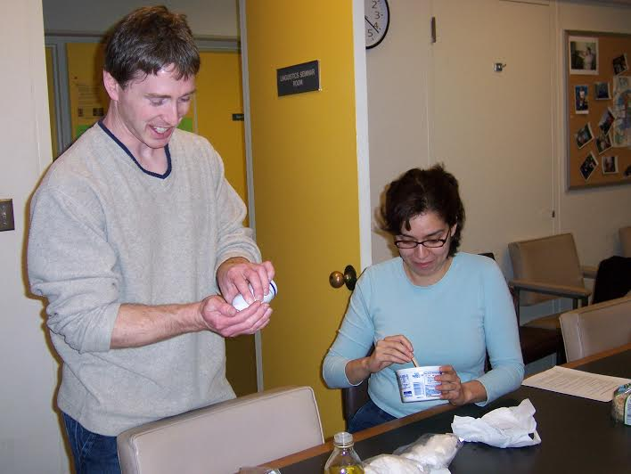
Experimental Phonetics

Slide 13
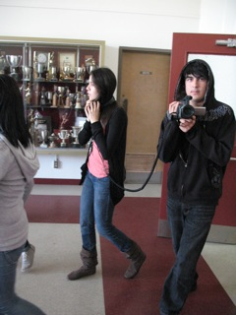
SKILLS 2011 students
Notes:
skills 2011 students

Slide 14
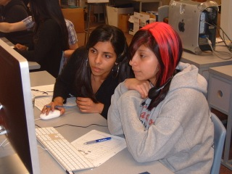
SKILLS 2011 students
Notes:
skills students 2011

Slide 15
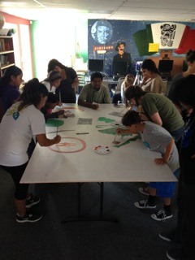
SKILLS 2014 students
Notes:
skills students 2014

Slide 16
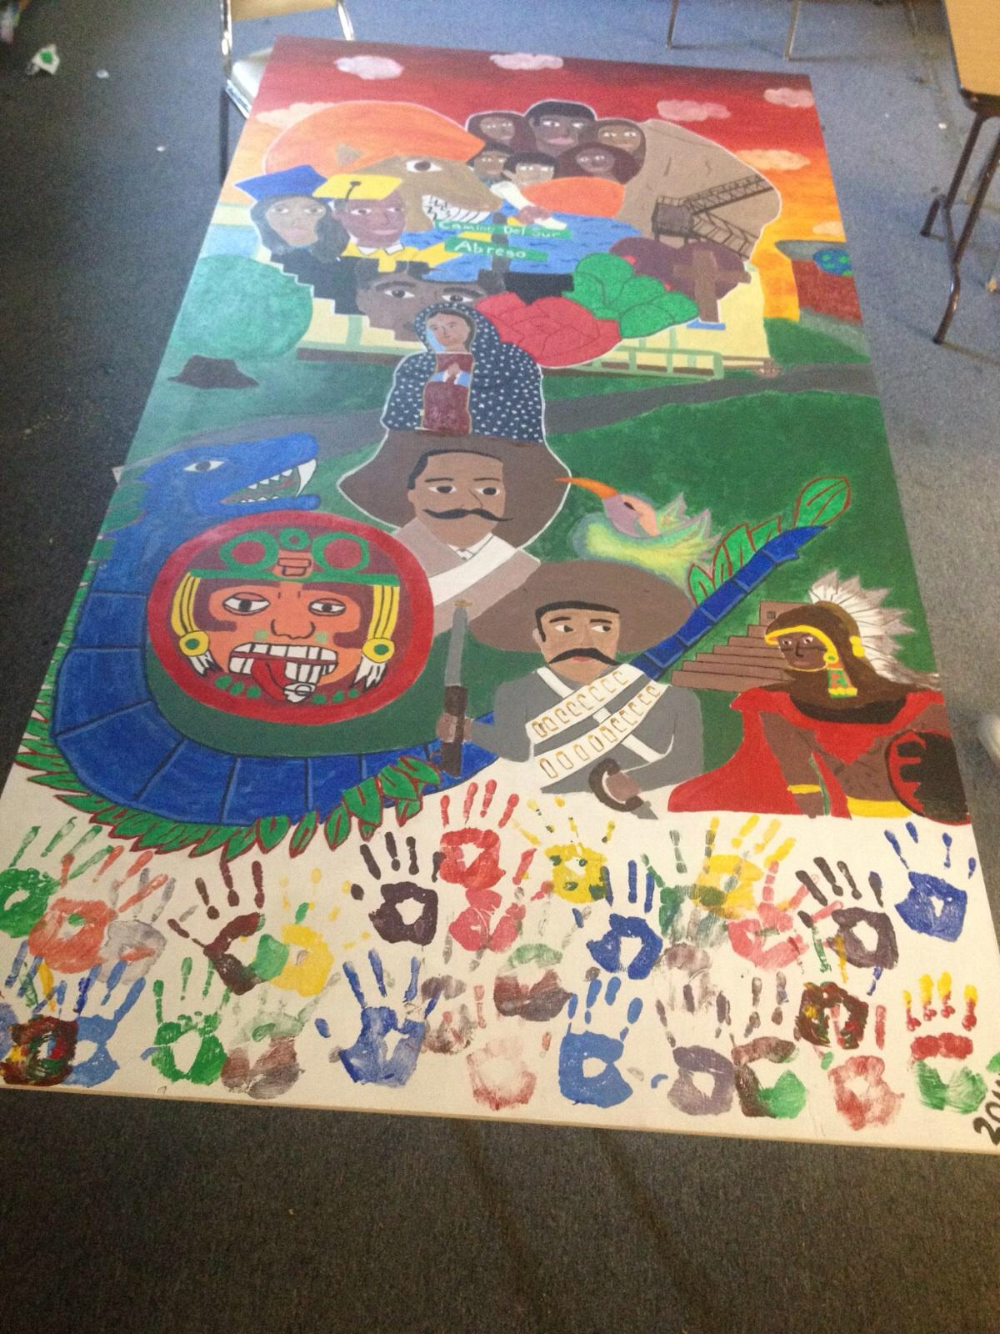
SKILLS 2014 student mural

Slide 17
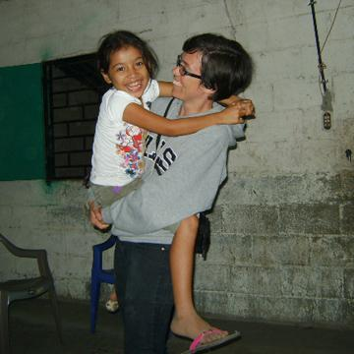
Lynnette Arnold in El Salvador

Slide 18
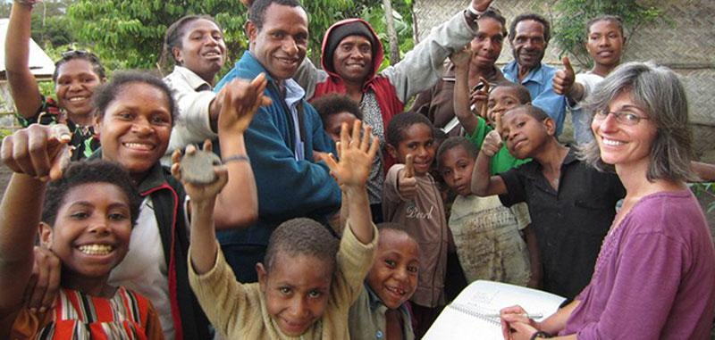
Andrea Berez
Notes:
Andrea

Slide 19
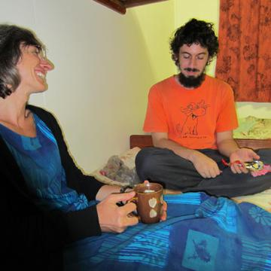
Andrea and Don Daniels
Notes:
Don Daniels and Andrea Berez

Slide 20
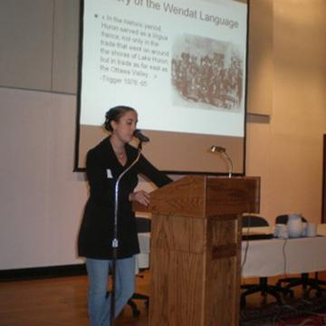
Megan Lukaniec on Wendat
Notes:
Megan Lukaniec - Wendat

Slide 21
Department, Graduation, and Individual Photos
Notes:
skills mural 2014

Slide 22
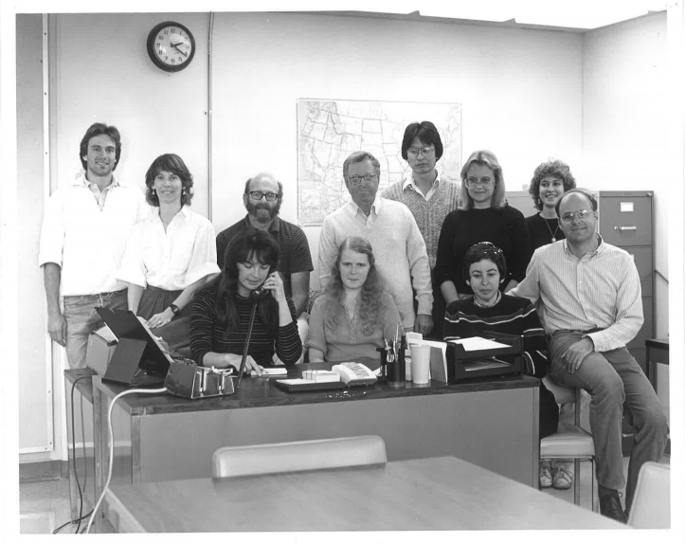
1984
Notes:
1984

Slide 23
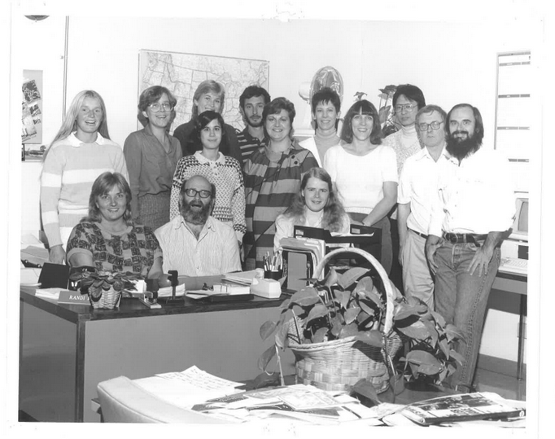
1985
Notes:
1985

Slide 24
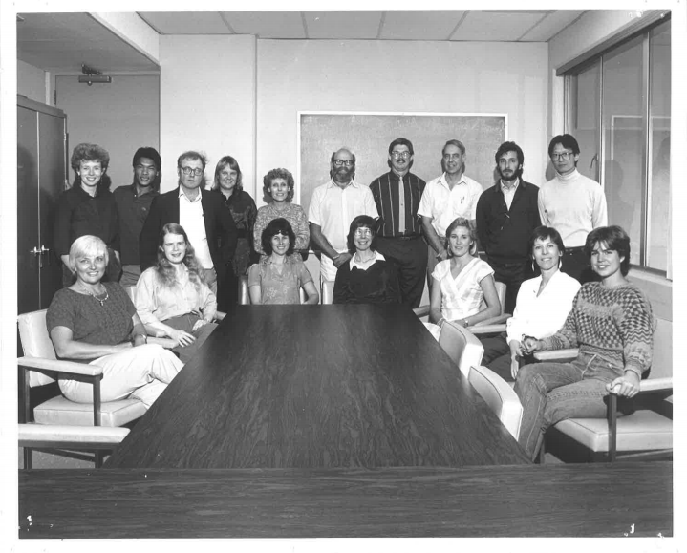
1986
Notes:
1986

Slide 25
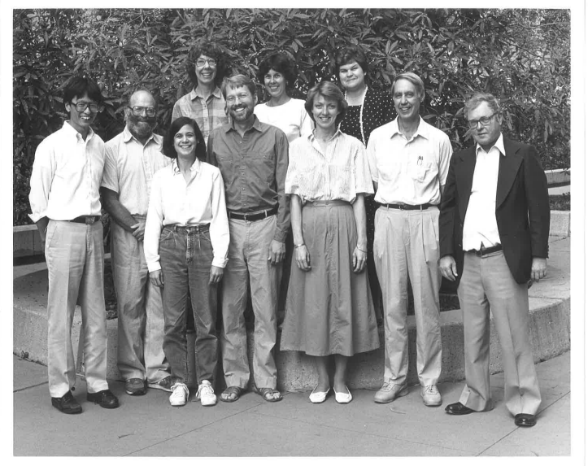
1988
Notes:
1988

Slide 26
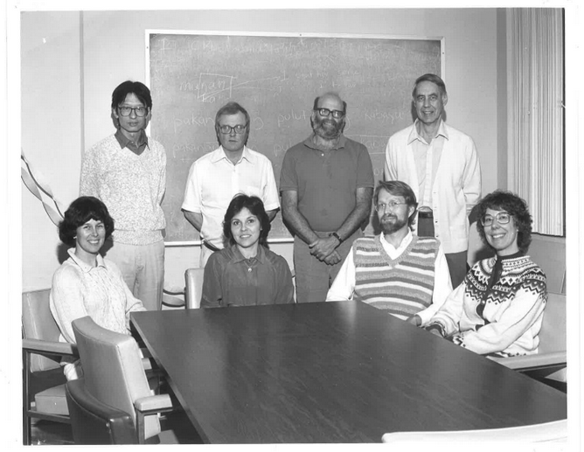
1988
Notes:
1988

Slide 27
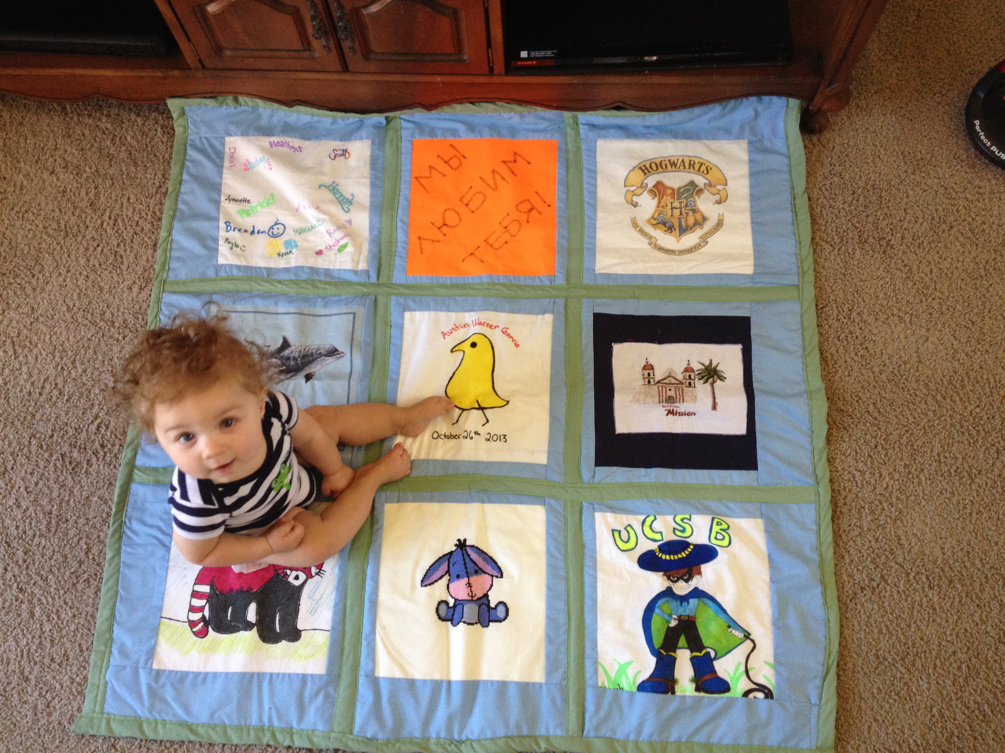
Austin Warner-Garcia on a linguistics grad student-made quilt
Notes:
Shawn Warner-Garcia’s son Austin on the ling quilt

Slide 28
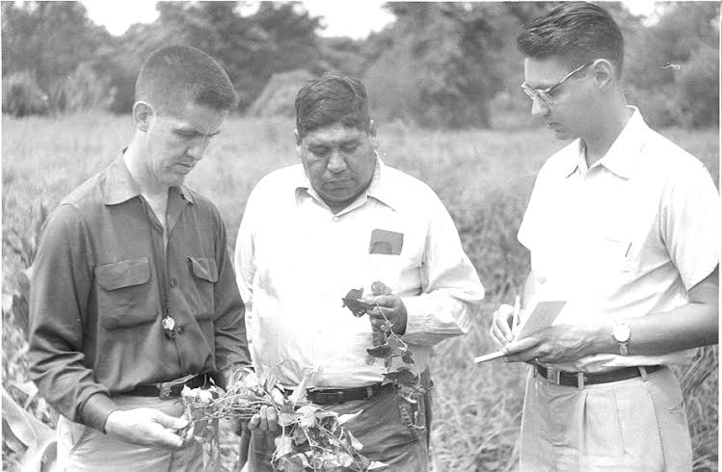
Guess who? (1957)
Notes:
guess who? 1957

Slide 29
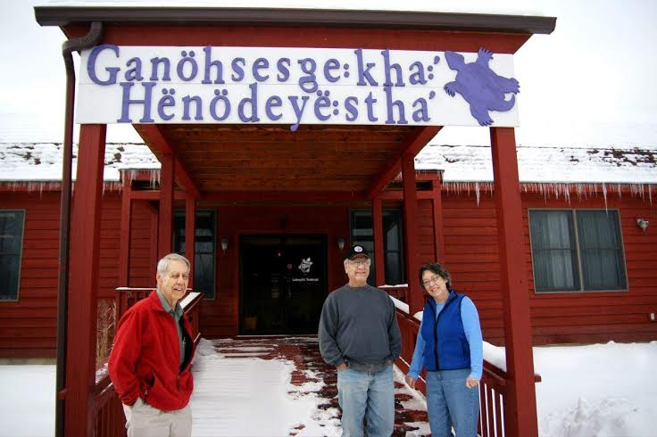
Wally Chafe, 2008
Notes:
Wally Chafe, 2008

Slide 30
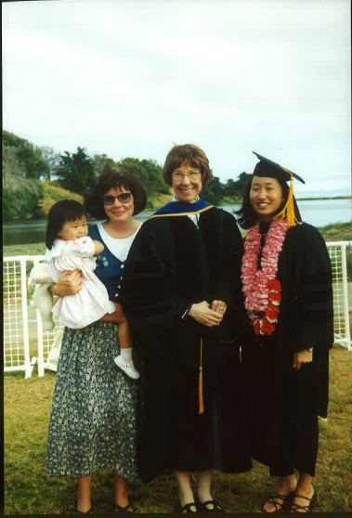
Graduation 2000
Notes:
graduation 2000

Slide 31
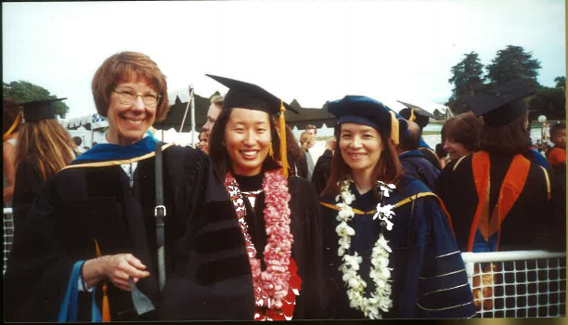
Graduation 2000
Notes:
graduation 2000

Slide 32
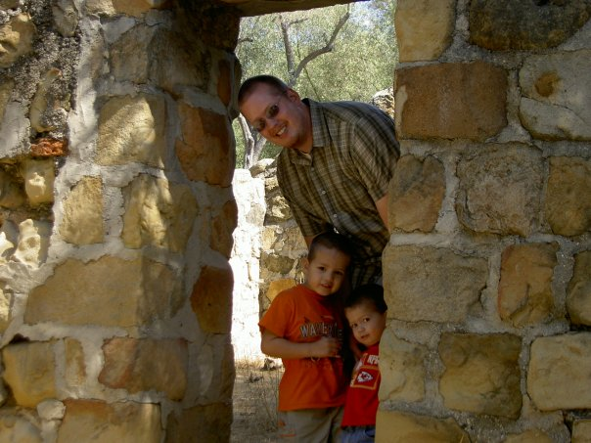
Alex Walker and family
Notes:
Alex Walker family

Slide 33
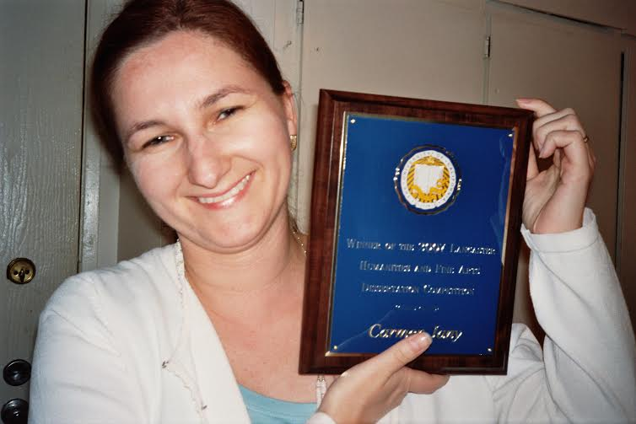
Graduation 2007
Notes:
Carmen Jany graduation

Slide 34
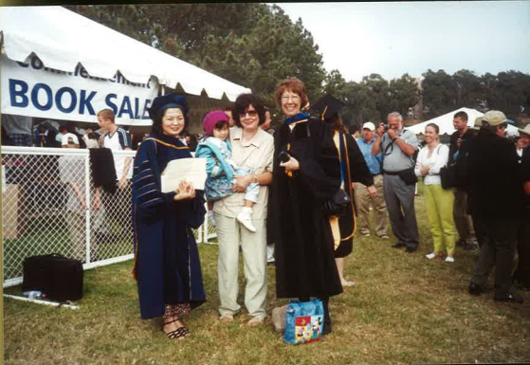
Graduation 2001
Notes:
graduation 2001

Slide 35
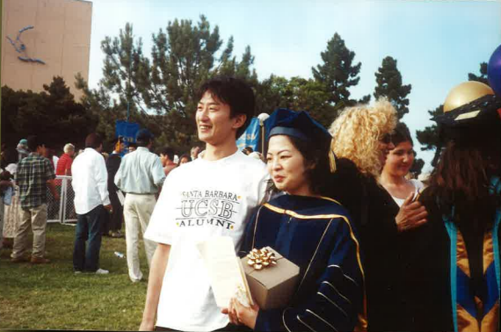
Graduation 2001
Notes:
graduation 2001

Slide 36
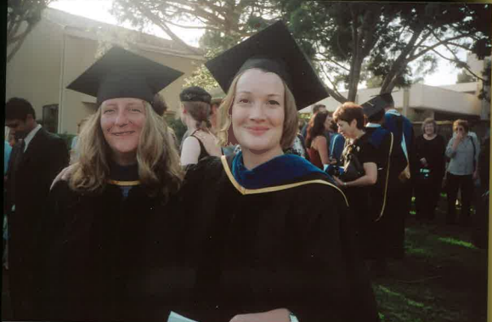
Graduation 2003
Notes:
graduation 2003

Slide 37
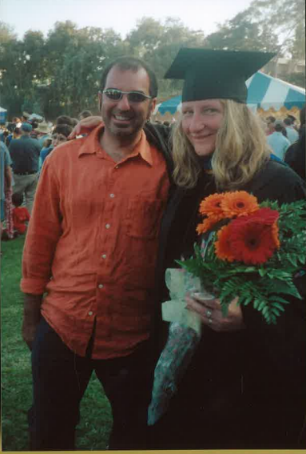
Graduation 2003
Notes:
graduation 2003

Slide 38
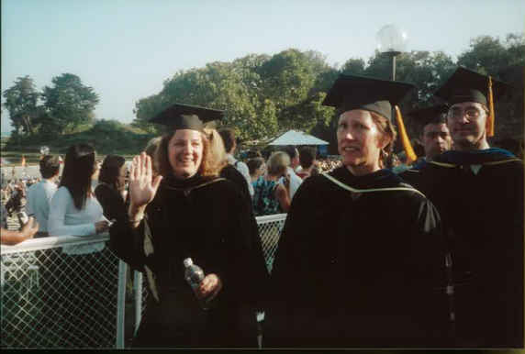
Graduation 2003
Notes:
graduation 2003

Slide 39
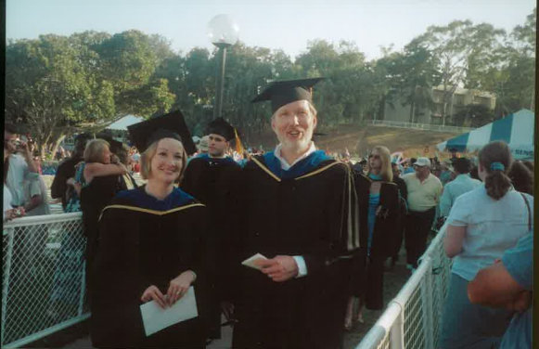
Graduation 2003
Notes:
graduation 2003

Slide 40
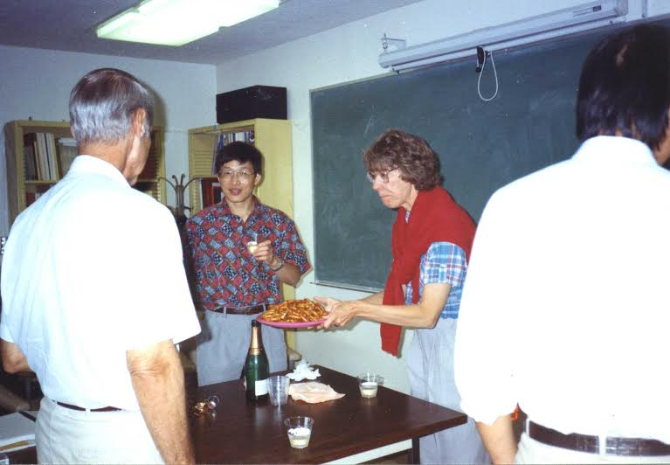
Orals Defense 1993
Notes:
Orals Defense, 1993

Slide 41
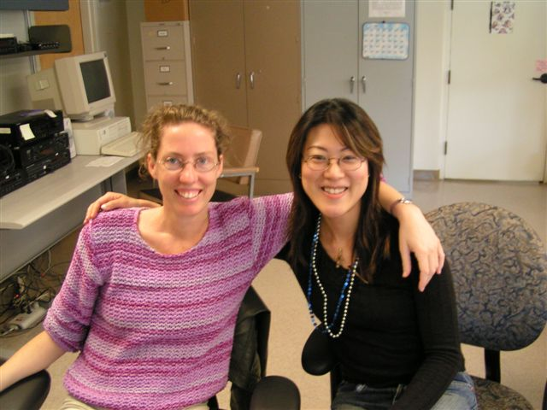
Hiroko mystery

Slide 42
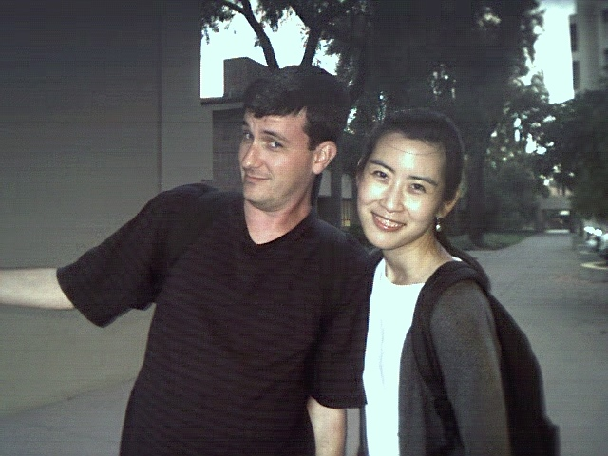

Slide 43
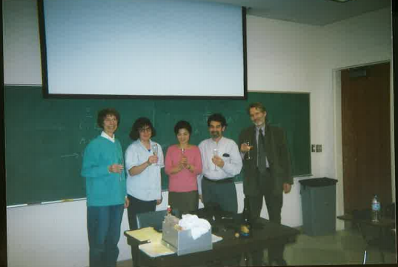
Tomoyo’s dissertation defense, 2001
Notes:
Tomoyo’s dissertation defense 2001

Slide 44
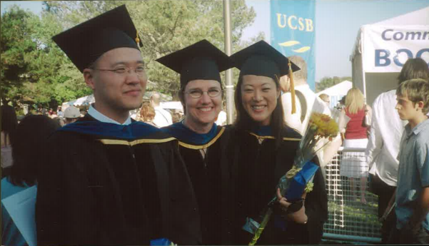
Graduation 2004
Notes:
graduation 2004

Slide 45
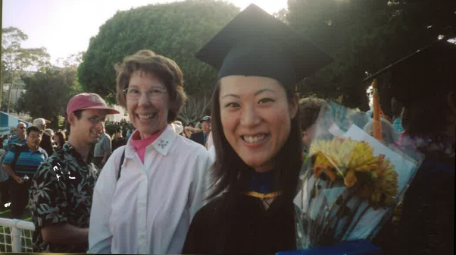
Graduation 2003

Slide 46
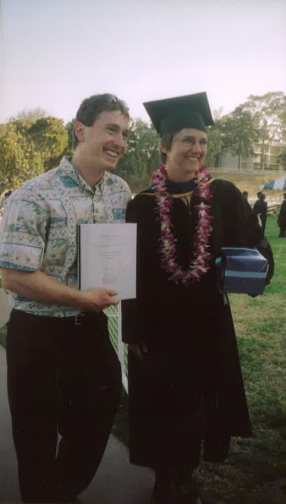
Graduation 2004
Notes:
graduation 2004

Slide 47
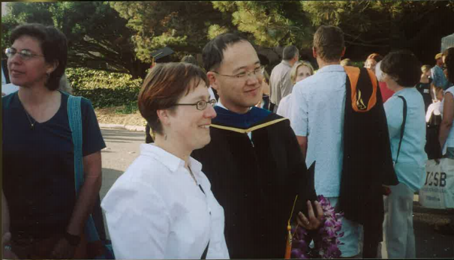
Graduation 2004

Slide 48
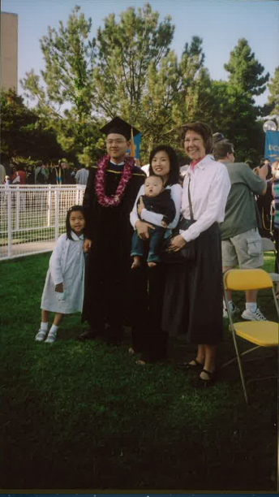
Graduation 2004
Notes:
graduation 2004

Slide 49
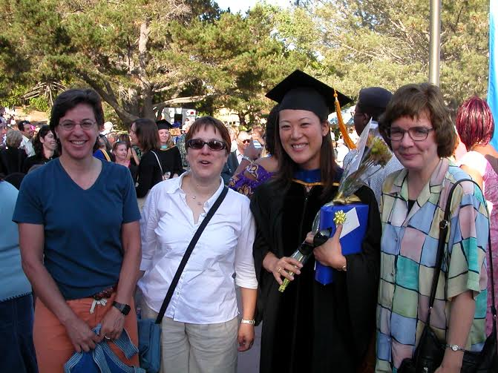
Graduation 2004
Notes:
graduation 2004

Slide 50
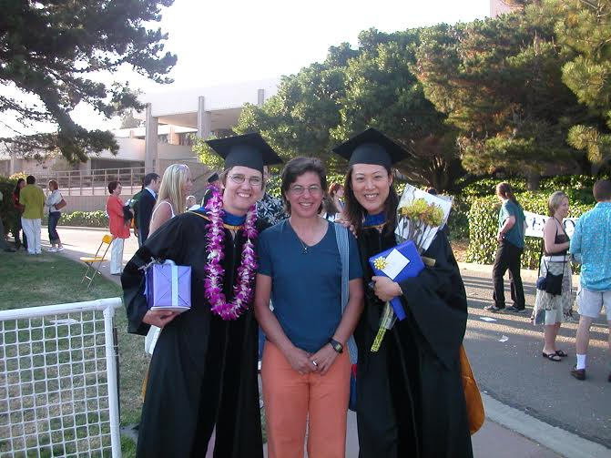
Graduation 2004
Notes:
graduation 2004

Slide 51
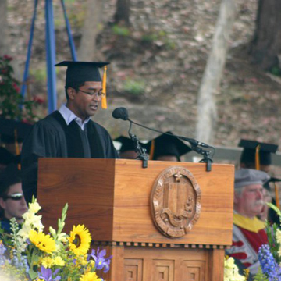
Graduation 2011
Notes:
Carlos Nash at graduation 2011

Slide 52
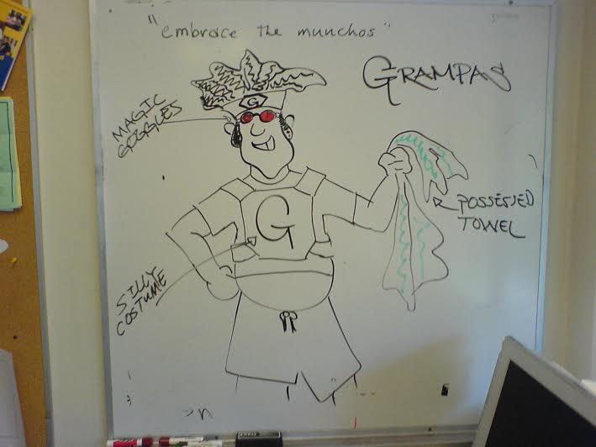
Tim Henry caricature
Notes:
Tim Henry caricature

Slide 53
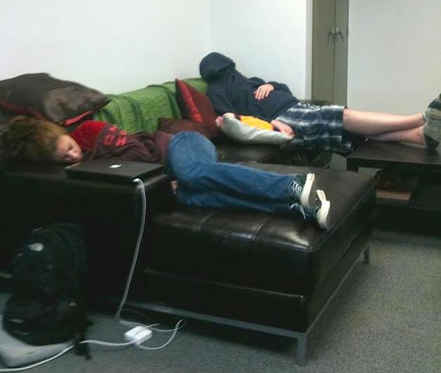
Sleepy students in the graduate linguistics lab
Notes:
sleepy students in the grad ling lab

Slide 54
Conferences and Workshops

Slide 55
InField 2008
Notes:
InField 2008

Slide 56
InField 2008

Slide 57
InField 2008

Slide 58
InField 2008

Slide 59
InField 2008

Slide 60
Himalayan Linguistics Symposium, 1997
Notes:
Himalayan linguistics symposium 1997

Slide 61
SKILLS Day 2011
Notes:
SKILLS day 2011

Slide 62
SKILLS Day 2011
Notes:
skills day 2011

Slide 63
SBHS Students at SKILLS Day 2011
Notes:
SKILLS Day 2011 – sbhs students

Slide 64
SKILLS Day 2011
Notes:
skills day 2011

Slide 65
SKILLS Day 2012
Notes:
SKILLS Day 2012

Slide 66
Edmonton International Cognitive Linguistics Conference, 2013
Notes:
Edmonton ICLC 2013

Slide 67
Edmonton ICLC, 2013
Notes:
Edmonton ICLC 2013 (honoring Wally Chafe)

Slide 68
Workshop on East Asian Languages, 1992
Notes:
WEAL 1992

Slide 69
Kyoto Restaurant – Santa Barbara, 1992
Notes:
Kyoto Restaurant – SB 1992

Slide 70
Kyoto 1992
Notes:
Kyoto 1992

Slide 71
Kyoto 1992
Notes:
Kyoto 1992

Slide 72
Cognition and Language Workshop (CLaW), 2013
Notes:
CLaW 2013

Slide 73
International Gender and Language Association (IGALA) conference, Vancouver 2014
Notes:
IGALA 2014 Vancouver

Slide 74
SKILLS Day 2013
Notes:
SKILLS Day 2013

Slide 75
SKILLS Day 2013
Notes:
SKILLS Day 2013

Slide 76
SKILLS Day 2013
Notes:
SKILLS day 2013

Slide 77
SKILLS Day 2013

Slide 78
SKILLS Day 2014
Notes:
skills day 2014

Slide 79
SKILLS Day 2014
Notes:
skills day 2014

Slide 80
CLIC-LISO 2005
Notes:
CLIC-LISO 2005

Slide 81
CLIC-LISO 2005
Notes:
CLIC-LISO 2005

Slide 82
CLIC-LISO 2005
Notes:
CLIC-LISO 2005

Slide 83
Parties and Get-Togethers

Slide 84
Department Christmas party, 1990
Notes:
Department xmas party 1990

Slide 85
Department Christmas party, 1990
Notes:
department xmas party 1990

Slide 86
Santa Barbara Botanical Gardens, 1990
Notes:
SB Botanical gardens 1990

Slide 87
Department Christmas party, 1991
Notes:
dept xmas 1991

Slide 88
Department Christmas party, 1991
Notes:
dept xmas 1991

Slide 89
Department Christmas party, 1991
Notes:
xmas 1991

Slide 90
Department Christmas party, 1991
Notes:
xmas 1991

Slide 91
Department Christmas party, 1991
Notes:
xmas 1991

Slide 92
Department Christmas party, 1991
Notes:
xmas 1991

Slide 93
Janie’s wedding
Notes:
Janie’ss wedding

Slide 94
Janie’s wedding
Notes:
Janie’s wedding

Slide 95
Visiting Scholar Dinner, 1995
Notes:
dinner with visiting scholars 1995

Slide 96
Hiking!
Notes:
mystery hike – Sarah Kriz

Slide 97
WAIL party
Notes:
WAIL party year unknown

Slide 98
WAIL party
Notes:
WAIL party year unknown

Slide 99
Halloween 1992 – guess who!
Notes:
Halloween 1992 - Pat

Slide 100
Halloween 1992 – guess who!
Notes:
Halloween 1992 - Jack

Slide 101
Halloween 1992 – Lila
Notes:
Halloween 1992 - Lila

Slide 102
Halloween 1992
Notes:
Halloween 1992

Slide 103
Halloween 1992

Slide 104
Halloween 1992

Slide 105
Halloween 1992

Slide 106
Halloween 1992
Notes:
Halloween 1992

Slide 107
LSA Institute Party 2001
Notes:
lsa institute party 2001

Slide 108
LSA Institute Party 2001
Notes:
LSA institute party 2001

Slide 109
LSA Institute Party 2001
Notes:
lsa institute party 2001

Slide 110
LSA Institute Party 2001

Slide 111
LSA Institute Party 2001

Slide 112
Notes:
m field’s photos

Slide 113
Department Christmas party, 1995
Notes:
dept xmas 1995

Slide 114
Department Christmas party, 1995
Notes:
dept xmas 1995

Slide 115
Department Christmas party, 1995
Notes:
dept xmas 1995

Slide 116
Department Christmas party, 1995
Notes:
dept xmas party 1995

Slide 117
End of the year picnic 1991
Notes:
eoy picnic 1991

Slide 118
End of the year picnic 1991
Notes:
eoy picnic 1991

Slide 119
End of the year picnic 1991
Notes:
eoy picnic 1991

Slide 120
End of the year picnic 1991
Notes:
eoy picnic 1991

Slide 121
End of the year picnic 1991
Notes:
eoy picnic 1991

Slide 122
Halloween 1991
Notes:
Halloween 1991

Slide 125
Solstice Parade 1995
Notes:
Solstice Parade 1995

Slide 126
Pat’s baby shower, 1997
Notes:
Pat’s baby shower 1997

Slide 127
Pat’s baby shower, 1997
Notes:
pat’s baby shower 1997

Slide 128
End of the year picnic 1995
Notes:
eoy picnic 1995

Slide 129
End of the year picnic 1998
Notes:
eoy picnic 1998

Slide 130
End of the year picnic 1998
Notes:
eoy picnic 1998

Slide 131
Jack’s birthday 2001
Notes:
jack’s birthday 2001

Slide 132
Jack’s birthday 2001
Notes:
jack’s bday 2001

Slide 133
Jack’s birthday 2001
Notes:
jack’s bday 2001

Slide 134
Linguistics party 2004
Notes:
ling party 2004

Slide 135
Linguistics party 2004
Notes:
ling party 2004

Slide 136
Linguistics party 2004
Notes:
ling party 2004

Slide 137
2004
Notes:
2004

Slide 138
Wally’s 80th birthday
Notes:
Wally’s 80th bday

Slide 139
Wally’s 80th birthday
Notes:
Wally’s 80th bday

